Slide 1
ANZ – Virtual Internship
Task-1: Exploratory Data Analysis
-By Pushyami Keerthi

Slide 2
Data Introduction
Business Context :
Based on a synthesized transaction dataset containing 3 months’ worth of transactions for 100 hypothetical customers. It contains purchases, recurring transactions, and salary transactions.
Business Problem:
To predict the annual salary for each customer using the attributes provided.
Data Introduction:
Data used for Exploration : DSynth_Output_100c_3m_v3
Scope of Data : Aug 2018- Oct 2018
Data Summary : 12043 observations ad 23 variables
Pay/Salary : 1676576.85AUD
Payment :201794.00
Data Preparation:
Dropped some of the columns like card_player_flag.
Imputed missing values with 0 and other categories.
Dropped columns with high number of missing percentage and low variance. (merchant_code)
91 unique dates in the dataset, (missing date: 2018-08-16)

Slide 3
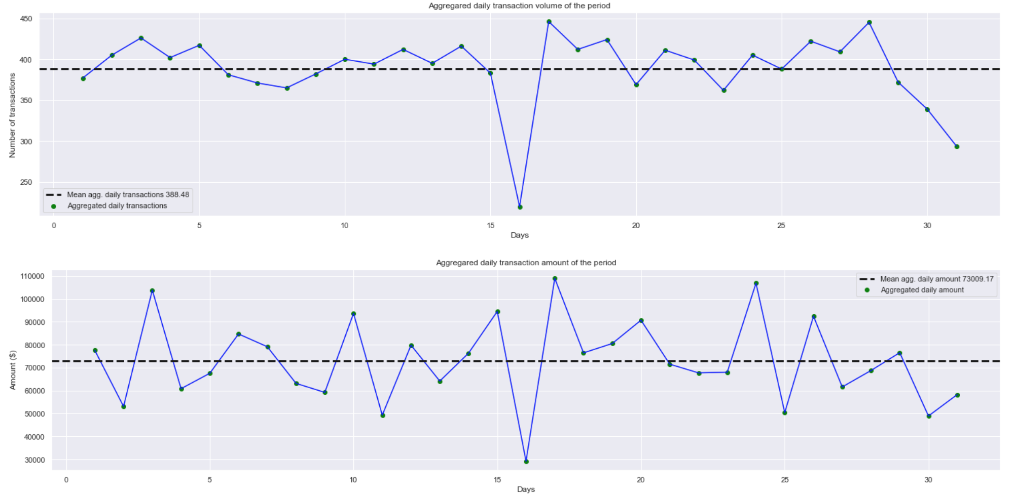
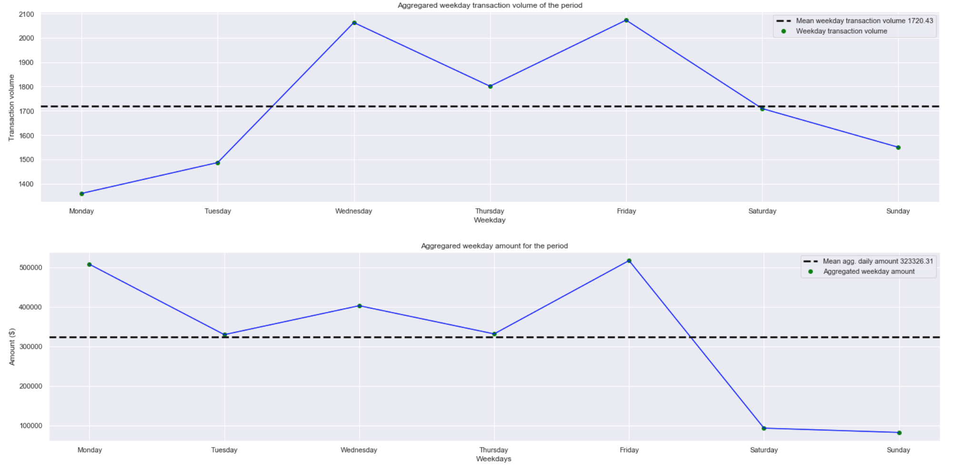
Timeseries analysis
These charts show aggregated transaction volume (left) and amount (right) for each day for the period combined.
During the analysis, I found that the amount spending and transaction volume was very low compared on the 16th day in the data set.
After performing further analysis, I found that 16th August is missing completely from the data set hence the reason why we see the drop in the volume and amount in the charts.
These charts show aggregated transaction volume (top) and amount (bottom) for each weekday for the period combined.
It was surprising to see that the transaction volume and amount spent on weekends (Sat-Sun) was less than weekdays (Mon-Fri).
My previous assumption was that people on average spend more money during weekends as most people do not work on weekends giving them more opportunity to spend due to the time off.

Slide 4
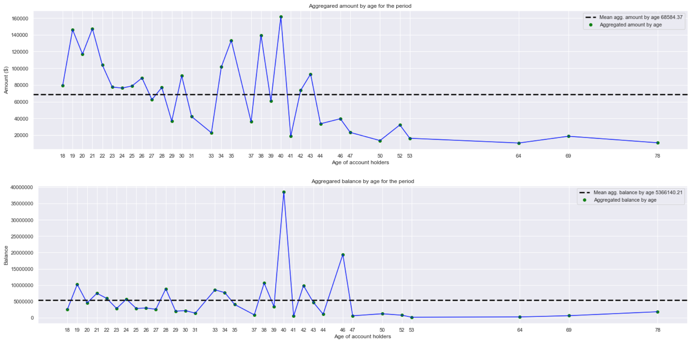
Timeseries analysis
These charts show aggregated amount spent (top) and balance (bottom) of customers by age.
Customers with the age 40 spent most amount as well as have most balance compared to customers with other ages.
Below analysis shows top 10 customers with highest balance at the end of the period (31/10/2018); top 10 customers with highest pay/salaries and top 10 age group with most pay/salaries paid for the whole period.
We can see that the pay is directly related to the balance amount.

Slide 5
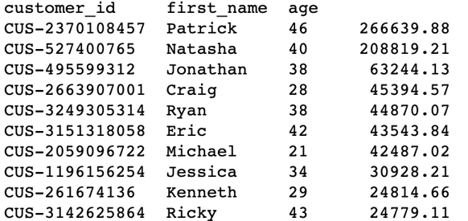
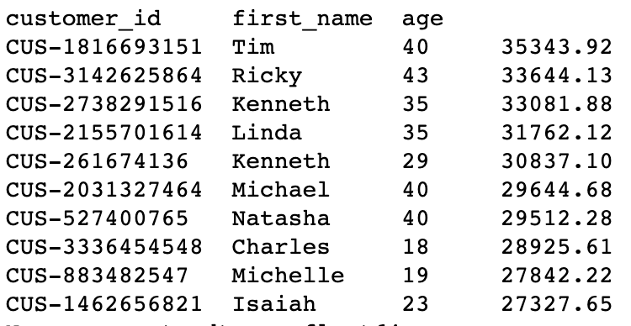
Customer analysis
Top 10 customers with highest balance
Top 10 customers with highest pay/salaries

Slide 6
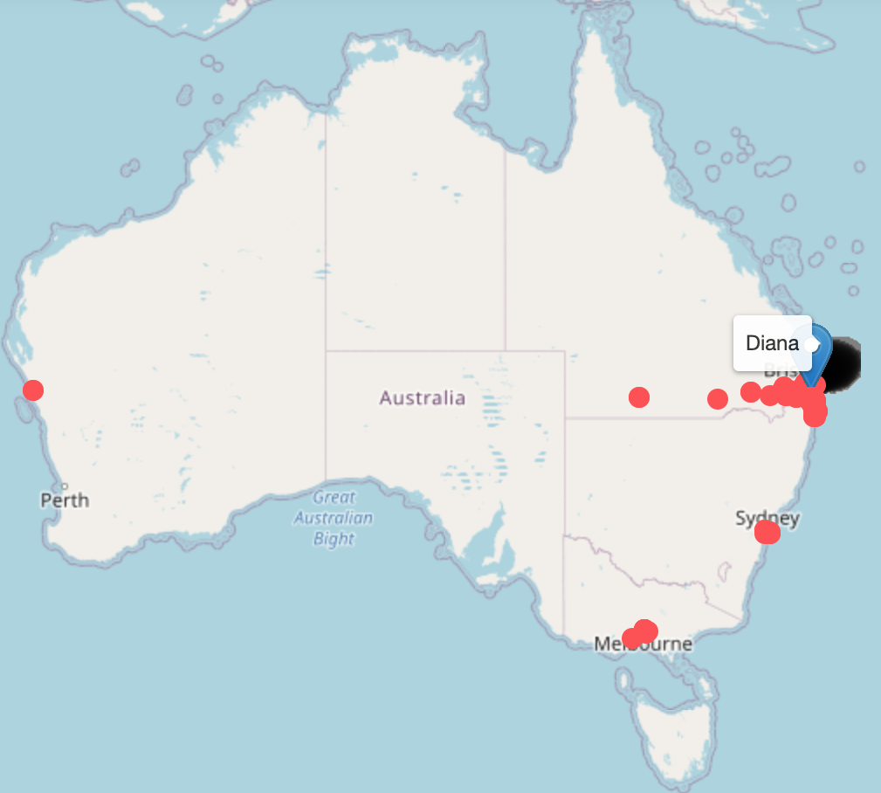
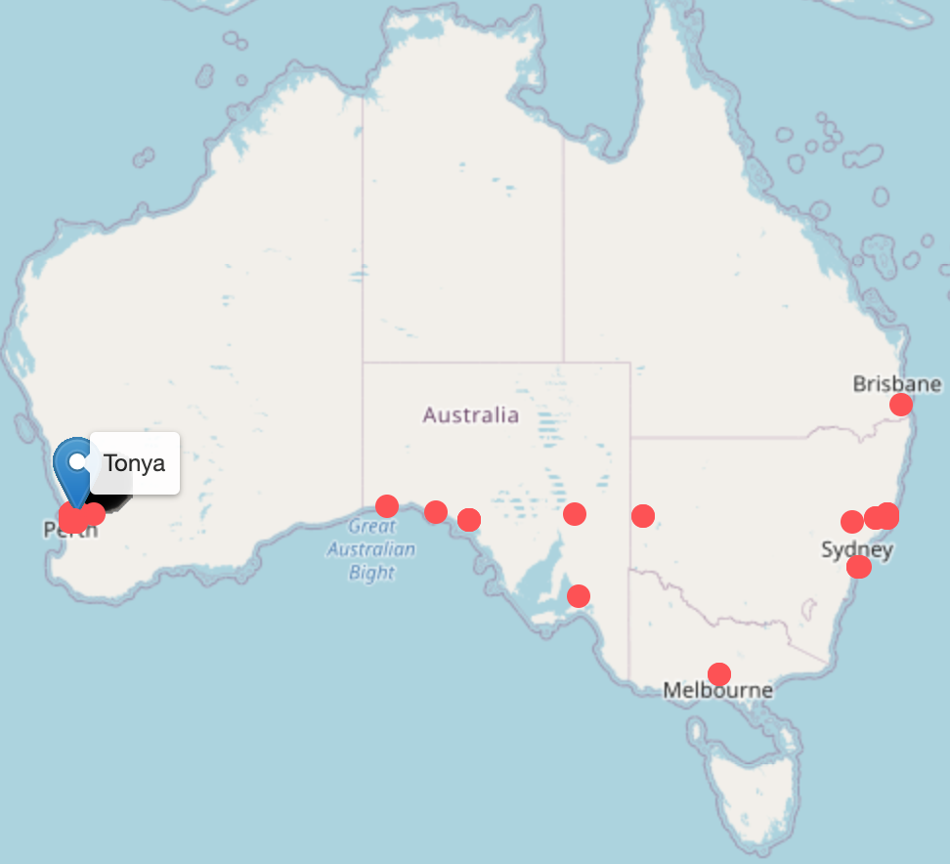
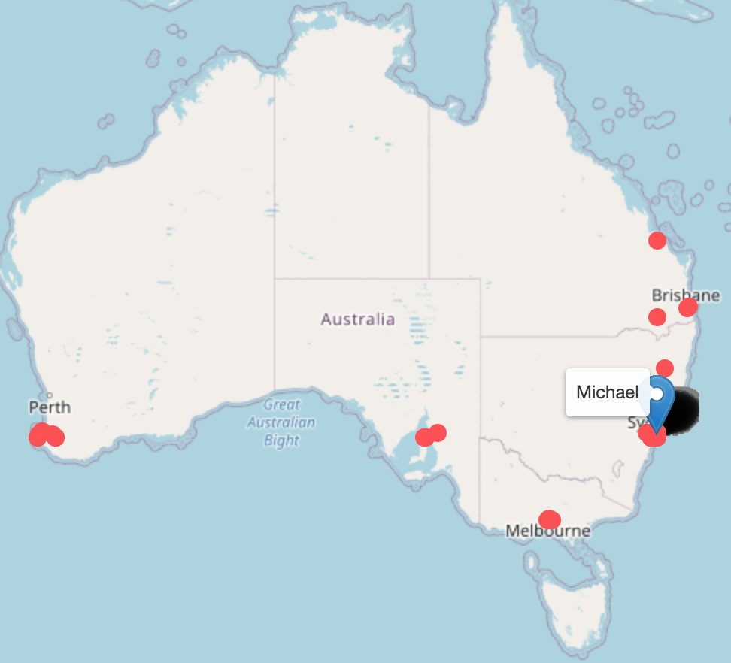
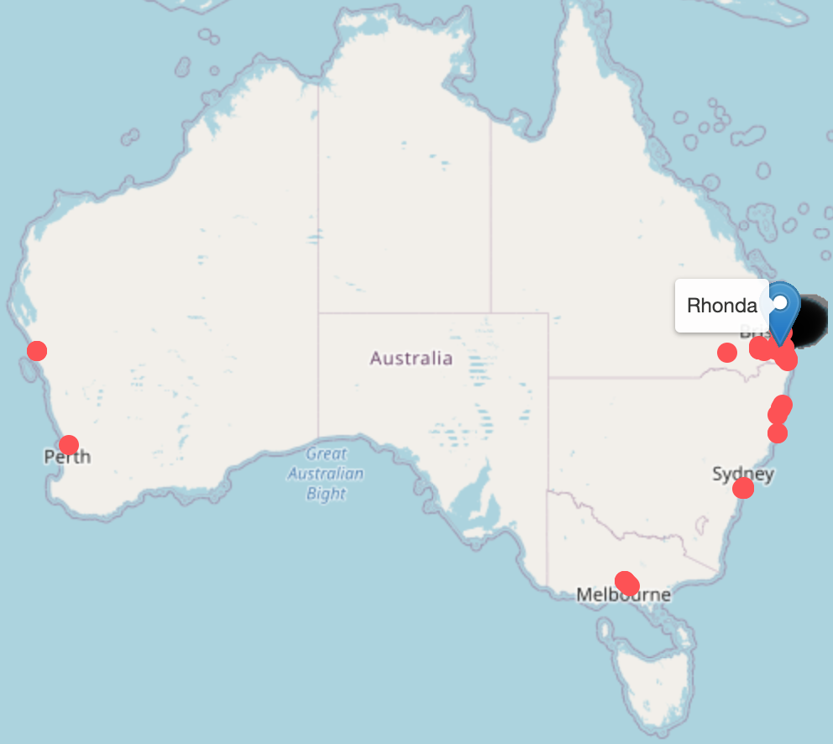
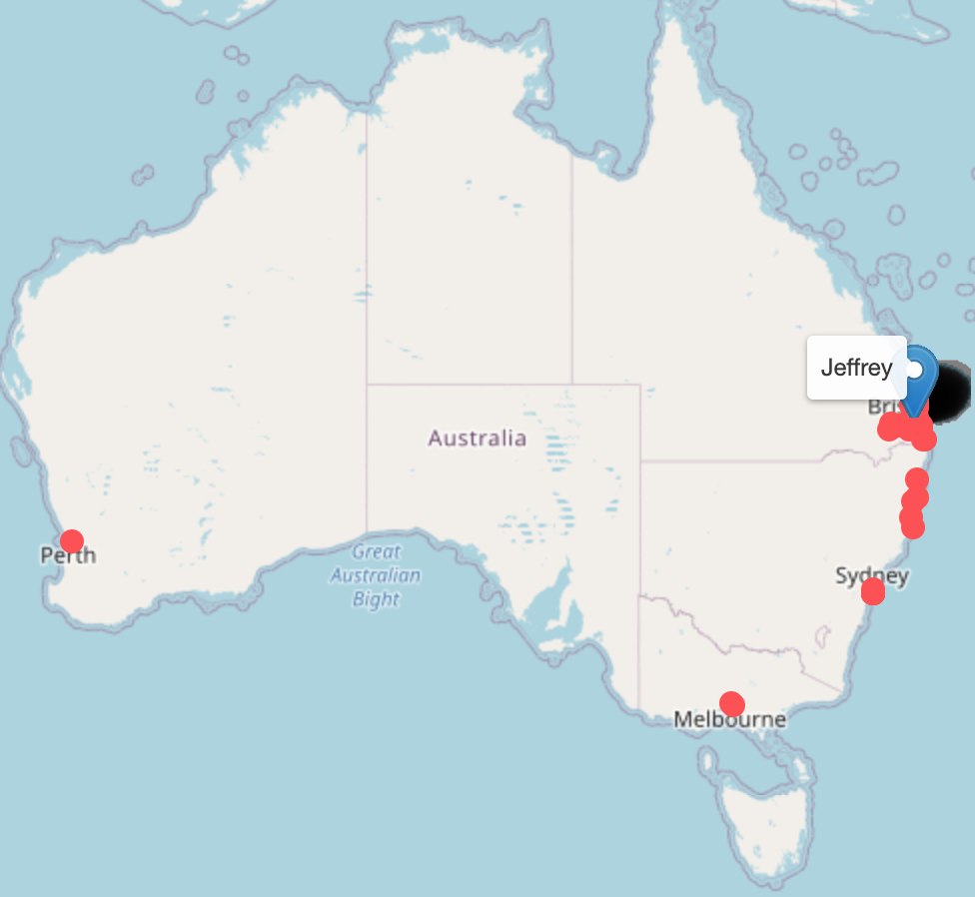
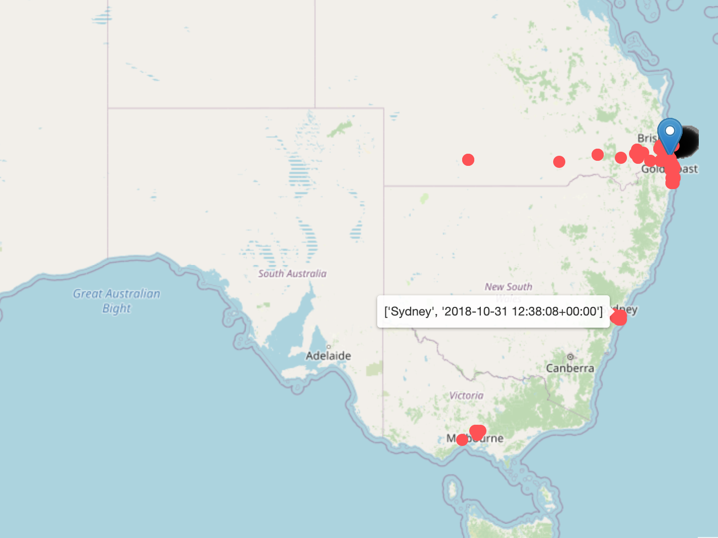


Location analysis
These maps show top 5 customers with most ‘POS/POS SALE’ transaction by volume (above).
We can see that the customers with most POS SALE transactions are travelling customers as we can see their footprint of transactions all over Australia.
The map on the right shows POS SALE transactions of Diana, as highlighted on the map we can see that Diana has a transaction stamp at Sydney at 12:38 PM and then at Geelong at 2:42 PM on the same day. From this we can conclude that Diana travelled from Sydney to Geelong.
This type of analysis can be useful to investigate fraud complaints.

Slide 7
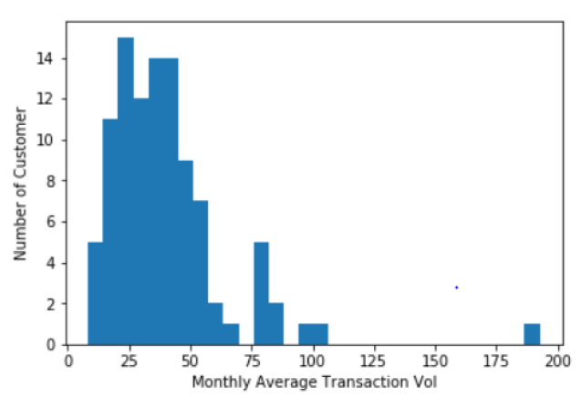
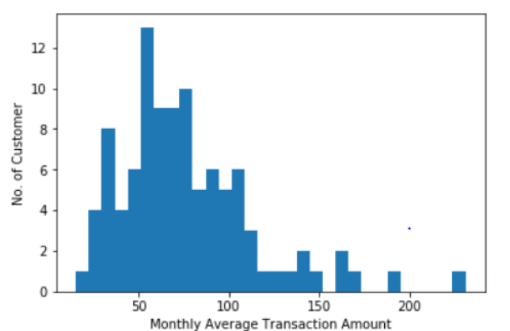
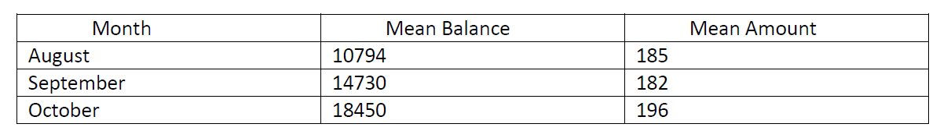
Monthly Average Transaction Volume
Monthly Average Transaction Amount

Slide 8
Insights :
The mean and usual account balance of the customers has varied from 10,000 to 20,000 AUD over the times. This does suggest that customers have been saving money, and their assets have grown.
The mean transaction bar plot shows that the value has remained fairly uniform over the ages, the total transaction has high rises for 22 and 34.
Pay/ salary has most of the transactions.
Males have done more transactions than females.
New South Wales and Victoria has most of the transactions and Queensland has few transactions amounts.
Victoria state has most of the balance maintained.
The Transactions amounts are higher in the month of September.
With respect to weekdays, Monday and Friday customers do most of the transactions.
With respect to months, On October we have maximum numbers of transactions done.
On 19th day of each month(aug, sept, oct) we have maximum number of transactions.

Slide 9
Insights :
With respect to card payments, Around 80% of the users pay via credit card/ Debit card .
Inside that 80% customers who uses card for payment, Around 90% of customers uses debit card.
In city wise, maximum transactions are from Sydney, Melbourne and Brisbane. These are the largest cities in Australia, and it is logical that largest transactions come from there.
Most spending is coming from the large cities of Australia and from some key states. The bank should look to expand its operations in these areas.
Most of the customers of the bank have made more credit transactions, as compared to debit transactions.
Some customers also have tendency to spend more than others, the average bank balance of the customers have increased. It indicates that the bank customers are getting well financially.
Highest Number of transactions made by Senior Citizen customers are 65 transactions and the transaction type is Sales-Pos
Highest Number of transactions made by customers below the age of 60 are 3869 transactions and the transaction type is Sales-Pos

Slide 10
Thank you !

